Slide 1
IOT enabled End to End control and reporting solution
Presenter Name

Slide 2
Agenda
01
Project Overview & Business Benefits
02
Architecture
03
System Components
04
Current progress
05
Next steps

Slide 3
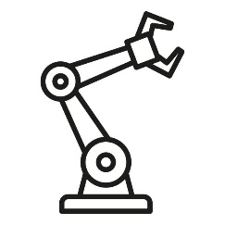
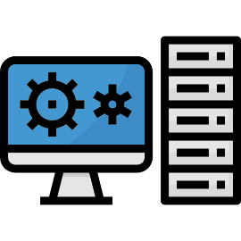

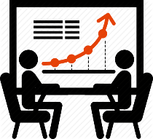
Project Overview
We aim to build a complete end-to-end cell monitoring and reporting solution by integrating advanced technologies with existing and new machines.
Our solution enables accurate real-time data capture, intuitive machine control, and streamlined reporting, driving operational efficiency and supporting Industry 4.0 transformation. Currently, the data collection process is entirely manual, leading to inefficiencies and inaccuracies.
Our approach replaces manual methods with automated, technology-driven systems to significantly enhance data accuracy, operational visibility, and overall productivity

Slide 4
Business Benefits: Unlocking Efficiency and Custom Insights
Real-Time Insights to Drive Efficiency and Green Initiatives
Comprehensive Loss Tracking and Coverage
Our end-to-end cell energy consumption reporting system offers real-time visibility into energy usage patterns, helping identify spikes, dips, and inefficiencies across operations. With actionable insights and monitoring tools, companies can take control of their energy strategy and make measurable progress toward sustainability goals.
This solution provides end-to-end visibility into various forms of operational losses, enabling manufacturers to track and address inefficiencies holistically. Key loss categories such as idle time, operator inefficiency, and energy wastage are captured and analyzed in real-time. By centralizing these insights, companies can quantify hidden losses, identify root causes, and implement corrective actions.
Driving Efficiency Through Energy and Production Insights
Automated Job Cards and Shift-End Operator Performance Reports
This project enhances operational efficiency at an overall level by providing real-time dashboards that help users identify and address inefficiencies across the production line. For example, one of our clients successfully reduced their cycle time from 286 to 250 seconds, directly increasing production output—demonstrating the tangible impact of data-driven optimization.
Auto-generated job cards track each operator’s shift performance—covering output, downtime, and quality. End-of-day reports deliver instant insights for supervisors, boosting accountability and cutting reporting time by 70%.
Optimizing Equipment and Labor Effectiveness
Custom Reports & Always-On Support
In alignment with TMP principles, this solution enables continuous monitoring and improvement of both OEE and OLE by providing granular visibility into machine performance and workforce productivity. By identifying bottlenecks, unplanned downtimes, and idle labor periods, manufacturers can take targeted actions that improve asset utilization and workforce efficiency.
Our reporting system is designed to be fully flexible—whether it’s tailoring KPIs, adjusting formats, or scheduling delivery, each report can be customized to align with your business goals. From shift-level summaries to energy-specific analytics, the output adapts to your operational priorities. Additionally, we provide continuous online support to ensure seamless usage.

Slide 5
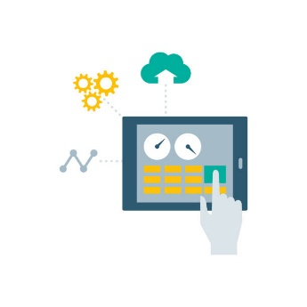




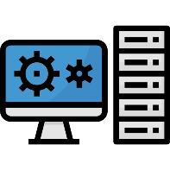
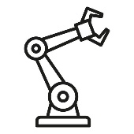
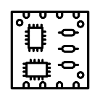

Architecture
HMI (Human Machine interface)
Server
Dashboard
Database
A customized real time progress tracking dashboards built using opensource web frameworks for inter operability and scalability
A Custom designed unified HMI application to control and monitor operations of the cell
Machine Data Collection
Master App
Operational Report Suite
Collect and process real-time data from the Machine PCB using custom designed scalable Master App.
Store and manage data using PostgreSQL for scalability and consistency.
Master App acts as a control hub between the HMI and Machine PCB.
Collect real-time data from the machine.
Execute operational commands from HMI on the machine (e.g., turning on Setup mode in a CNC).
A Custom designed suite of day to day reports and monitoring platform

Slide 6
Architecture
HMI (Human Machine interface)
Server
Dashboard
Database
A customized real time progress tracking dashboards built using opensource web frameworks for inter operability and scalability
A Custom designed unified HMI application to control and monitor operations of the cell
Machine Data Collection
Master App
Operational Report Suite
Collect and process real-time data from the Machine PCB using custom designed scalable Master App.
Store and manage data using PostgreSQL for scalability and consistency.
Master App acts as a control hub between the HMI and Machine PCB.
Collect real-time data from the machine.
Execute operational commands from HMI on the machine (e.g., turning on Setup mode in a CNC).
A Custom designed suite of day to day reports and monitoring platform

Slide 7
Architecture
HMI (Human Machine interface)
Server
Dashboard
Database
A customized real time progress tracking dashboards built using opensource web frameworks for inter operability and scalability
A Custom designed unified HMI application to control and monitor operations of the cell
Machine Data Collection
Master App
Operational Report Suite
Collect and process real-time data from the Machine PCB using custom designed scalable Master App.
Store and manage data using PostgreSQL for scalability and consistency.
Master App acts as a control hub between the HMI and Machine PCB.
Collect real-time data from the machine.
Execute operational commands from HMI on the machine (e.g., turning on Setup mode in a CNC).
A Custom designed suite of day to day reports and monitoring platform

Slide 8
Architecture
HMI (Human Machine interface)
Server
Dashboard
Database
A customized real time progress tracking dashboards built using opensource web frameworks for inter operability and scalability
A Custom designed unified HMI application to control and monitor operations of the cell
Machine Data Collection
Master App
Operational Report Suite
Collect and process real-time data from the Machine PCB using custom designed scalable Master App.
Store and manage data using PostgreSQL for scalability and consistency.
Master App acts as a control hub between the HMI and Machine PCB.
Collect real-time data from the machine.
Execute operational commands from HMI on the machine (e.g., turning on Setup mode in a CNC).
A Custom designed suite of day to day reports and monitoring platform

Slide 9
Architecture
HMI (Human Machine interface)
Server
Dashboard
Database
A customized real time progress tracking dashboards built using opensource web frameworks for inter operability and scalability
A Custom designed unified HMI application to control and monitor operations of the cell
Machine Data Collection
Master App
Operational Report Suite
Collect and process real-time data from the Machine PCB using custom designed scalable Master App.
Store and manage data using PostgreSQL for scalability and consistency.
Master App acts as a control hub between the HMI and Machine PCB.
Collect real-time data from the machine.
Execute operational commands from HMI on the machine (e.g., turning on Setup mode in a CNC).
A Custom designed suite of day to day reports and monitoring platform

Slide 10
Architecture
HMI (Human Machine interface)
Server
Dashboard
Database
A customized real time progress tracking dashboards built using opensource web frameworks for inter operability and scalability
A Custom designed unified HMI application to control and monitor operations of the cell
Machine Data Collection
Master App
Operational Report Suite
Collect and process real-time data from the Machine PCB using custom designed scalable Master App.
Store and manage data using PostgreSQL for scalability and consistency.
Master App acts as a control hub between the HMI and Machine PCB.
Collect real-time data from the machine.
Execute operational commands from HMI on the machine (e.g., turning on Setup mode in a CNC).
A Custom designed suite of day to day reports and monitoring platform

Slide 11
Current Progress
Aqua pump HMI and Dashboard Migration Kick off
Nov-24
Dec-24
Gathered Requirements and started with Development
Deployed applications for first round of testing
Jan-25
Feb-25
Successfully integrated all the feedback and deployed the application in production
Started with development of reporting suite
Mar-25
April-25
Partnered with Embedded systems expert to develop PCB design
Partner with Craftsman to develop and deliver the end-to-end reporting and monitoring solution
May-25

Slide 12
Next steps
PCB Design and Manufacturing
01
Partner with experts to finalize and fin tune the design
Reporting Suite
02
Master App
A work in progress application in our pipeline, complete the module and add it to the current product pipeline
03
The development is yet to begin as we are finalizing our partner for our pcb needs
End to End Execution
04
To complete all modules and deploy the solution in a production environment to monitor the accuracy.

Slide 13
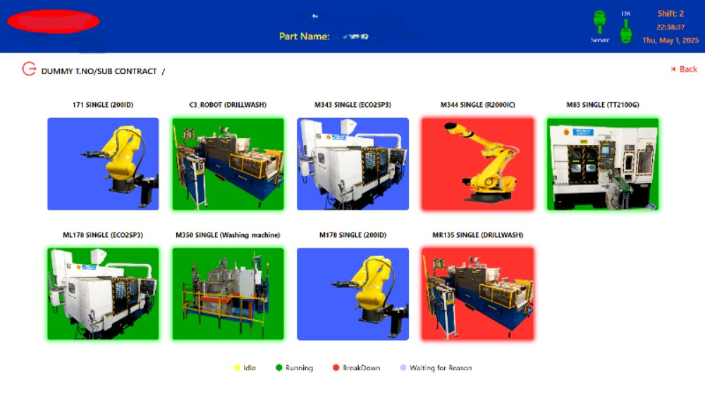
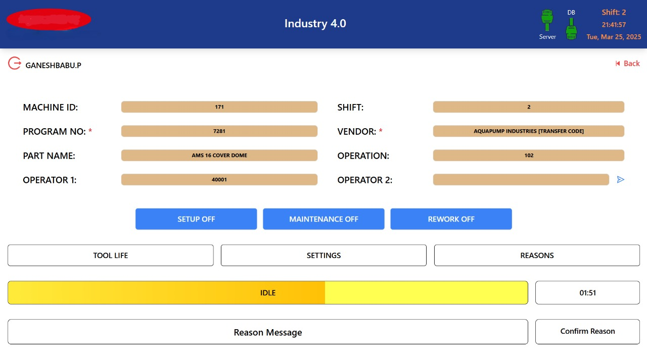
Components of the System - HMI

Slide 14
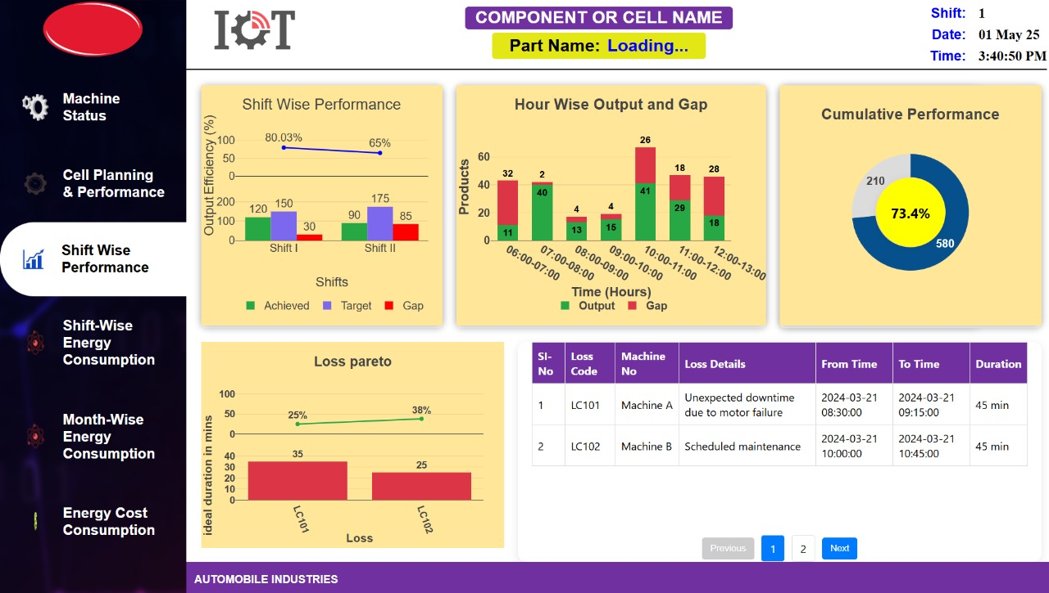
Components of the System - Dashboard

Slide 15
Our Team

Slide 16
Thank You

